Slide 1
GCSE Photography Introductory Tasks
SUMMER PREPARATION
BOOKLET 2021
GCSE PHOTOGRAPHY / SUMMER PREPARATION
Miss Morris / Head of Art & Design and Photography

Slide 2
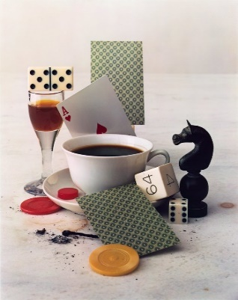
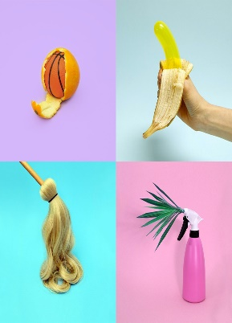
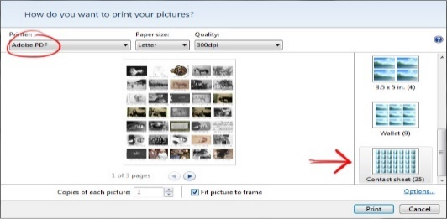
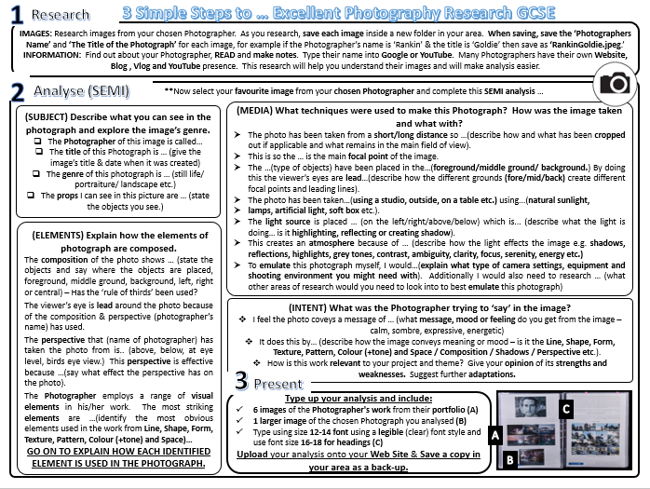
GCSE Photography Introductory Project
Task 2: ARTIST RESEARCH
Enter Text here …
Write your ‘Shoot Plan’ that explains how you will set up your photography shoot in the style of your chosen Photographer. Consider what props, lighting, location, backgrounds, compositional elements and viewpoints you might use. Type up your ‘Shoot Plan’ on your A3 PowerPoint & save.
Take your shoot of at least 20 photographs. Download these onto your computer and print screen (Ctrl+PrtScr) them onto your A3 PowerPoint slide & save.
Select the 3 best images from your shoot then edit using www.pixlr.com or your own software. Add these images to your A3 PowerPoint & save.
TOP TIP: TAKE SCREEN SHOTS OF YOUR EDITING BY PRINT SCREENING YOUR WORK (Ctrl+PrtScr)
Describe how your ‘shoot’ went and evaluate the strengths and weaknesses of your final images. What would you do next if you were to plan another shoot? How well does your work link with the Photographer. What did you learn? Add to your A3 PowerPoint, save and upload to Class-Charts / Share-Point.
Task 3: PLAN
Everyday Objects are popular subject genre in Still Life Photography. Getting in close on an ordinary subject is a good way to look, and think, about it a bit differently.
Irving Penn, After-
dinner games, 1947
Research the Still Life work of either Irving Penn , Vanessa McKeown or Jim Golden.
Choose 6 of your favourite images of your chosen Photographer's work and collage them together using www.photocollage.com/. Add to your A3 PowerPoint sheet & save.
Next, choose one image from your photographer, something that you might be able to re-create at home, and analyse using the SEMI analysis worksheet. (You may remember using SEMI in KS3 Art). Add this research to your A3 PowerPoint sheet & save.
To prepare yourselves for the start of your Photography GCSE we would like you to complete the following three tasks over June, July and in your Summer Holidays.
You have chosen Photography and we hope that you will be as passionate about the subject as we are. This means that we expect you to show dedication by completing the following tasks to the best of your ability and then submit them on Class-Charts ready for your first lesson in September.
Each project should take A MINIMUM OF FOUR HOURS OF YOUR TIME. Please email me if you have problems to g.morris@penworthamgirls.lancs.sch.uk.
When PRESENTING your work, you need to set up a PowerPoint slide to A3 size. You must not hand write – all annotation is to be typed up using size 12 font only. Headings can be in size 16 font. Please choose a professional typeface (or font) that is legible (readable).
EVERYDAY OBJECTS / STILL LIFE
Task 4: CREATE
Jim Golden, Camera
Collection (caption), 2013
Vanessa McKeown
Task 1: CREATE 1st A3 SHEET
Task 5: EVALUATE
Watch the video on YouTube and set up your PowerPoint to A3 & Landscape.
https://www.youtube.com/watch?v=08NdIsOiKzA
Save your new PowerPoint as SummerProjectYourName. Using a computer is a major part of GCSE Photography so it is important to get used to using one regularly.
Miss Morris / Head of Art & Design and Photography

Slide 3
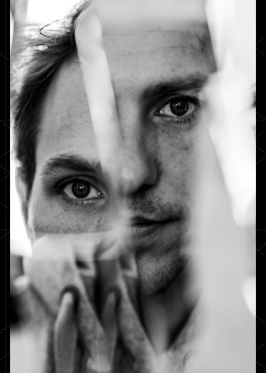
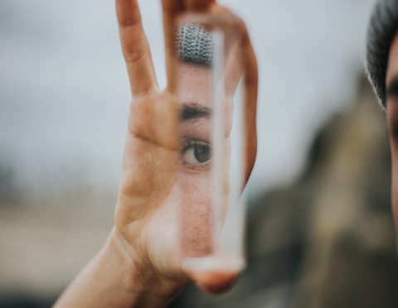
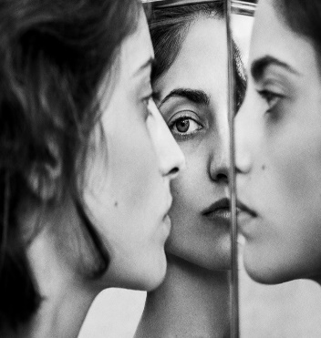
GCSE Photography Introductory Project
Task 2: TECHNIQUE RESEARCH
Enter Text here …
Write your ‘Shoot Plan’ that explains how you will set up your photography mirror shoot. Consider what props, lighting, location, backgrounds, compositional elements and viewpoints you might use. Type up your ‘Shoot Plan’ on your A3 PowerPoint & save.
Take your shoot of at least 20 photographs. Download these onto your computer and print screen (Ctrl+PrtScr) them onto your A3 PowerPoint slide & save.
Select the 3 best images from your shoot then edit using www.pixlr.com or your own software. Add these images to your A3 PowerPoint & save.
TOP TIP: TAKE SCREEN SHOTS OF YOUR EDITING BY PRINT SCREENING YOUR WORK (Ctrl+PrtScr)
Describe how your ‘shoot’ went and evaluate the strengths and weaknesses of your final images. What would you do next if you were to plan another shoot? How well were you able to use mirror photography? What did you learn? Add to your A3 PowerPoint, save and upload to Class-Charts.
Task 3: PLAN
Reflection photography, also referred to as mirror photography, is when you use reflective surfaces, such as a mirror or water to create an artistic echo of a scene. This type of photography can add an interesting effects to your portraiture shoots.
Reflections in surfaces such as water, mirror glass, windows and metallic objects are sometimes recorded by photographers and filmmakers to create distorted images or to frame a view.
Research examples of ‘Mirror Photography’ or ‘Reflection Photography’ using Pinterest & Google. Choose 12 of your favourite inspirational images to create an IMAGE BANK then collage them together using www.photocollage.com/. Add to your A3 PowerPoint sheet & save.
Research techniques on how to create ‘Mirror Photography’ on YouTube. Choose your favourite technique, type it up on your A3 PowerPoint and include images on how to create this technique. Save your work.
Here are some examples https://www.youtube.com/watch?v=fvcUGlwonww
To prepare yourselves for the start of your Photography GCSE we would like you to complete the following three tasks over June, July and in your Summer Holidays.
You have chosen Photography and we hope that you will be as passionate about the subject as we are. This means that we expect you to show dedication by completing the following tasks to the best of your ability and then submit them on Class-Charts ready for your first lesson in September.
Each project should take A MINIMUM OF FOUR HOURS OF YOUR TIME. Please email me if you have problems to g.morris@penworthamgirls.lancs.sch.uk.
When PRESENTING your work, you need to set up a PowerPoint slide to A3 size. You must not hand write – all annotation is to be typed up using size 12 font only. Headings can be in size 16 font. Please choose a professional typeface (or font) that is legible (readable).
Task 4: CREATE
MIRROR PHOTOGRAPHY / PORTRAITURE
Task 1: CREATE 2nd A3 SHEET
Task 5: EVALUATE
Create a 2nd sheet on your PowerPoint. Save your PowerPoint as SummerProjectYourName.
Using a computer is a major part of GCSE Photography so it is important to get used to using one regularly.
Miss Morris / Head of Art & Design and Photography

Slide 4
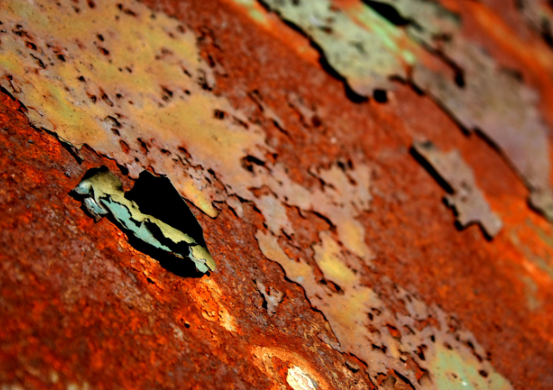
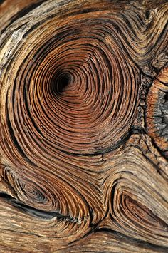
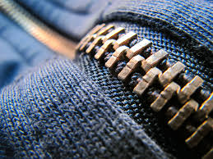
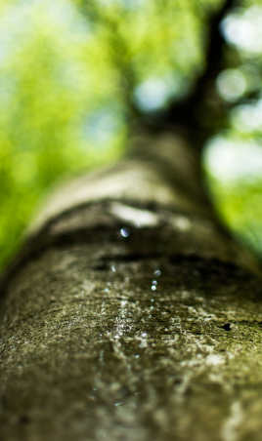
GCSE Photography Introductory Project
Task 2: ARTIST RESEARCH
Task 3: PLAN
Enter Text here …
Write your ‘Shoot Plan’ that explains how you will set up your texture walk (indoors or outdoors). Bring a tripod or make a DIY tripod to stabilise your images. Type up your ‘Shoot Plan’ on your A3 PowerPoint & save.
Take your shoot of at least 20 photographs. Download these onto your computer and print screen (Ctrl+PrtScr) them onto your A3 PowerPoint slide & save.
Select the 3 best images from your shoot then edit using www.pixlr.com or your own software. Add these images to your A3 PowerPoint & save.
TOP TIP: TAKE SCREEN SHOTS OF YOUR EDITING BY PRINT SCREENING YOUR WORK (Ctrl+PrtScr)
Describe how your ‘shoot’ went and evaluate the strengths and weaknesses of your final images. What would you do next if you were to plan another shoot? How well were you able to capture textures around you? What did you learn? Add to your A3 PowerPoint, save and upload to Class-Charts.
Macro Photography enables us capture amazing details from the textures all around us. Some cameras have a macro setting that allows you to get close, other DSLR cameras have Macro Lens attachments. You can even get pretty close with your own camera phone but in all cases you must hold VERY still or use a tripod.
Get close and look for textures and patterns in surfaces such as wood, fabrics, zips, rusty objects, flooring, inside washing machines, nature, bricks and stones etc. Macro or Close up Photography will create some wonderfully abstract images.
Research examples of ‘Texture Photography.’ Choose 12 of your favourite inspirational images to create an IMAGE BANK and collage them together using https://www.photocollage.com/. Add to your A3 PowerPoint sheet & save.
Research the work of Lucy Shires. Choose 6 of your favourite images of your chosen Photographer's work and collage them together using www.photocollage.com/. Add to your A3 PowerPoint sheet & save.
Next, choose one image from Lucy Shire’s Texture work, and analyse using the SEMI analysis worksheet.
To prepare yourselves for the start of your Photography GCSE we would like you to complete the following three tasks over June, July and in your Summer Holidays.
You have chosen Photography and we hope that you will be as passionate about the subject as we are. This means that we expect you to show dedication by completing the following tasks to the best of your ability and then submit them on Class-Charts ready for your first lesson in September.
Each project should take A MINIMUM OF FOUR HOURS OF YOUR TIME. Please email me if you have problems to g.morris@penworthamgirls.lancs.sch.uk.
When PRESENTING your work, you need to set up a PowerPoint slide to A3 size. You must not hand write – all annotation is to be typed up using size 12 font only. Headings can be in size 16 font. Please choose a professional typeface (or font) that is legible (readable).
MACRO PHOTOGRAPHY / TEXTURE
Task 4: CREATE
Task 1: CREATE 3rd A3 SHEET
Task 5: EVALUATE
Create a 3rd sheet on your PowerPoint. Save your PowerPoint as SummerProjectYourName.
Using a computer is a major part of GCSE Photography so it is important to get used to using one regularly.
Miss Morris / Head of Art & Design and Photography

Slide 5
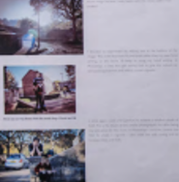
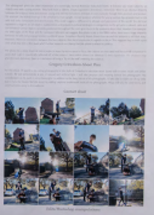
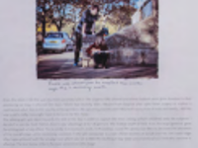
GCSE Photography HOME LEARNING
IMAGE BANK X 12 / ARTIST IMAGES X 6
EXAMPLE LAYOUT / PRESENTATION
EDITED IMAGES / SCREEN SHOTS
CHOSEN IMAGE FROM ARTIST / IMAGE BANK
SEMI ANALYSIS / TECHNIQUES
SHOOT PLAN
FINAL IMAGE
CONTACT SHEET X 20 IMAGES
EVALUATION
Miss Morris / Head of Art & Design and Photography

Slide 6
Miss Morris / Head of Art & Design and Photography

Slide 7
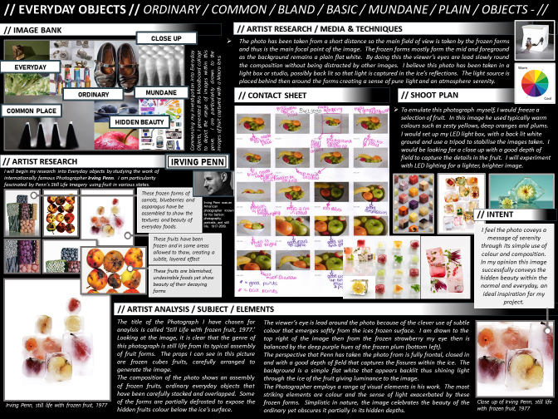

Slide 8
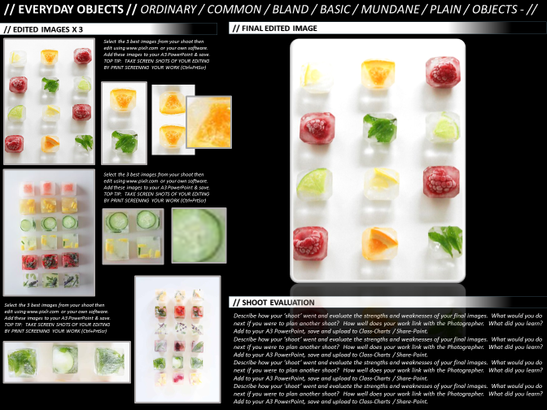

Slide 9
GCSE Photography HOME LEARNING
Lab.
SUMMER PREPARATION
BOOKLET 2020
GCSE PHOTOGRAPHY / SUMMER PREPARATION
Miss Morris / Head of Art & Design and Photography

Slide 10
Over the Summer holidays we would like you to complete the following tasks. You can use this PowerPoint as a Template for your work.
You have chosen to do Photography so that means your enjoy taking pictures and using a computer.
Please email me if you have problems to g.morris@penworthamgirls.lancs.sch.uk
Please start typing into this PowerPoint at it has already been set up to A3 size for you. Click here to start editing it.
Only use size 12 font when typing.
INTRODUCTION
Miss Morris / Head of Art & Design and Photography

Slide 11
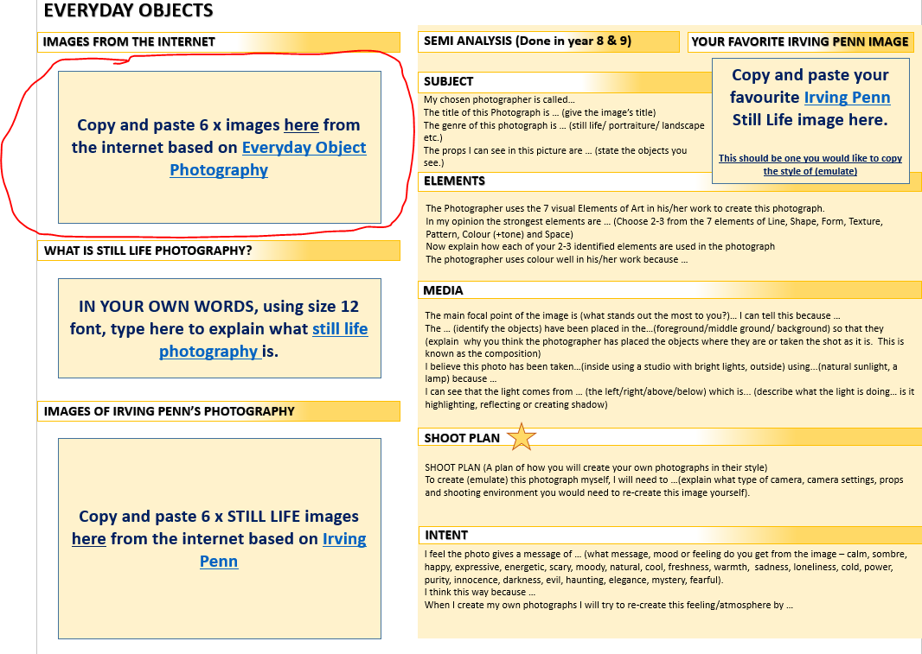
Task 1: IMAGES FROM THE INTERNET
Copy and paste 6 x images from the internet based on Everyday Object Photography
EVERYDAY OBJECTS / STILL LIFE
Example
Miss Morris / Head of Art & Design and Photography

Slide 12
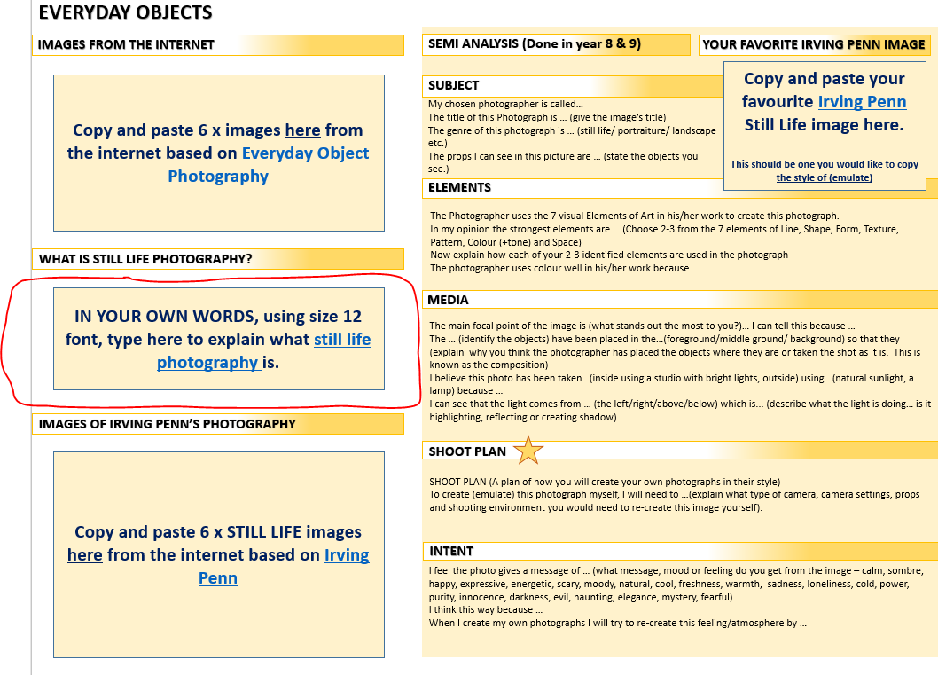
Task 2: Find out what Still Life Means
IN YOUR OWN WORDS, using size 12 font, type to explain what still life photography is.
EVERYDAY OBJECTS / STILL LIFE
Example
Still life photography is …
Miss Morris / Head of Art & Design and Photography

Slide 13
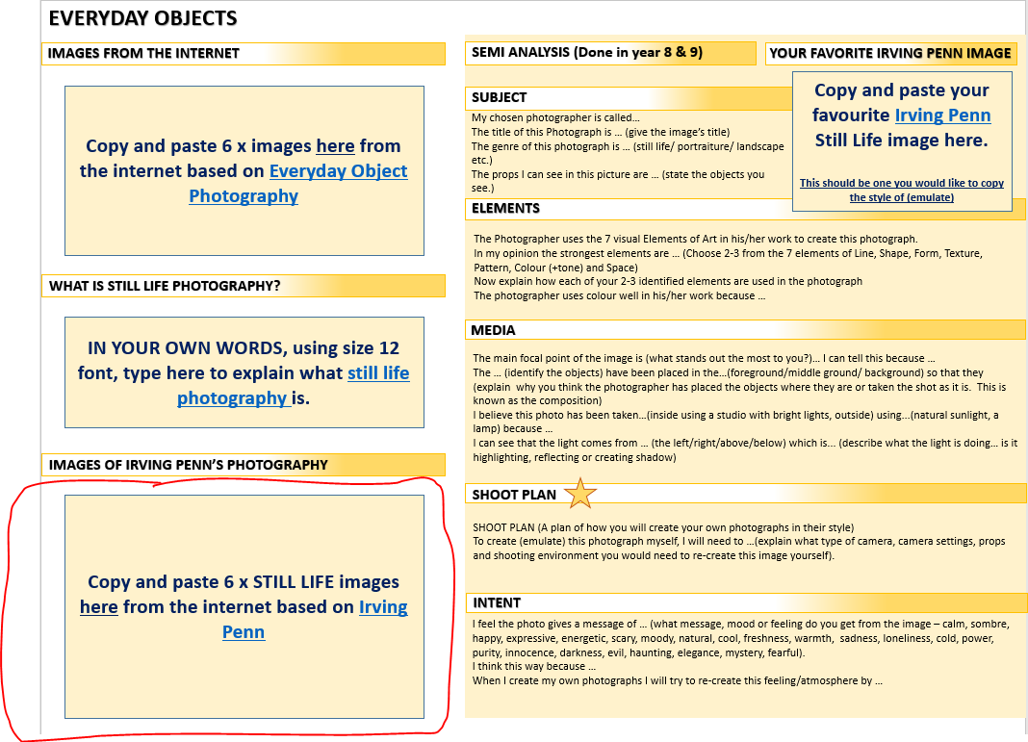
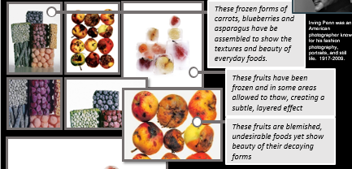
Task 3: Collect images
Copy and paste 6 x STILL LIFE images from the internet based on Irving Penn
EVERYDAY OBJECTS / STILL LIFE
Example
Miss Morris / Head of Art & Design and Photography

Slide 14
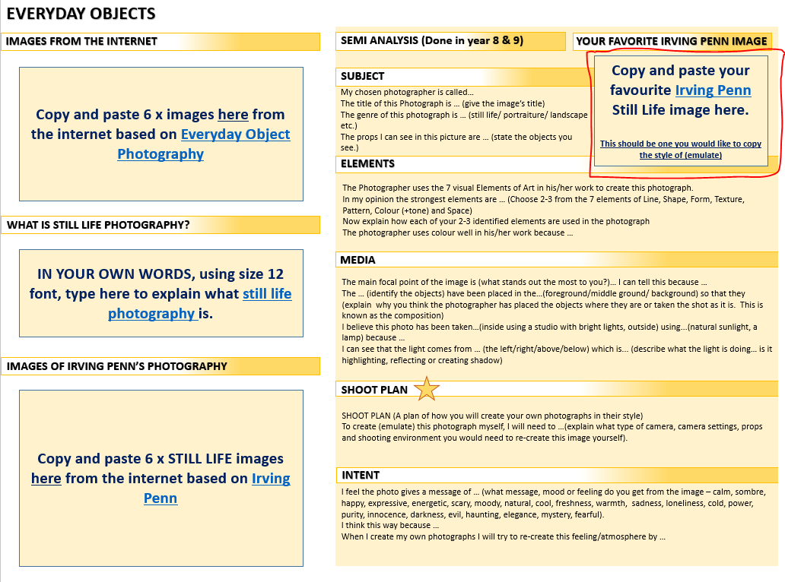
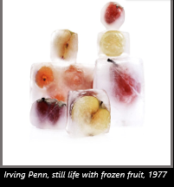
Task 4: Choose 1 best image
Copy and paste your favourite Irving Penn Still Life image here.
This should be one you would like to copy the style of (emulate)
EVERYDAY OBJECTS / STILL LIFE
Example
Miss Morris / Head of Art & Design and Photography

Slide 15
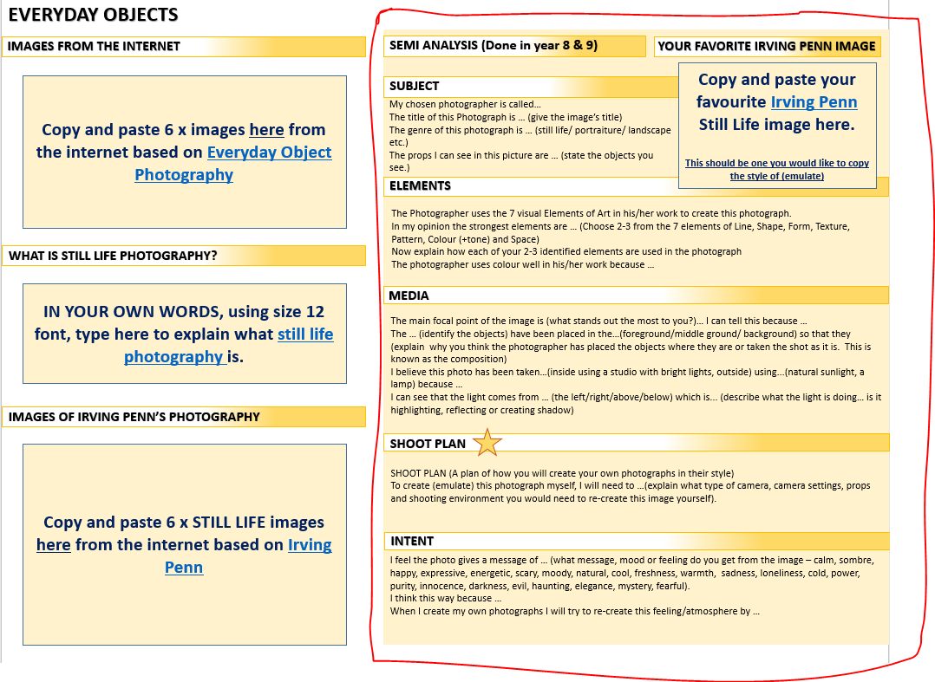
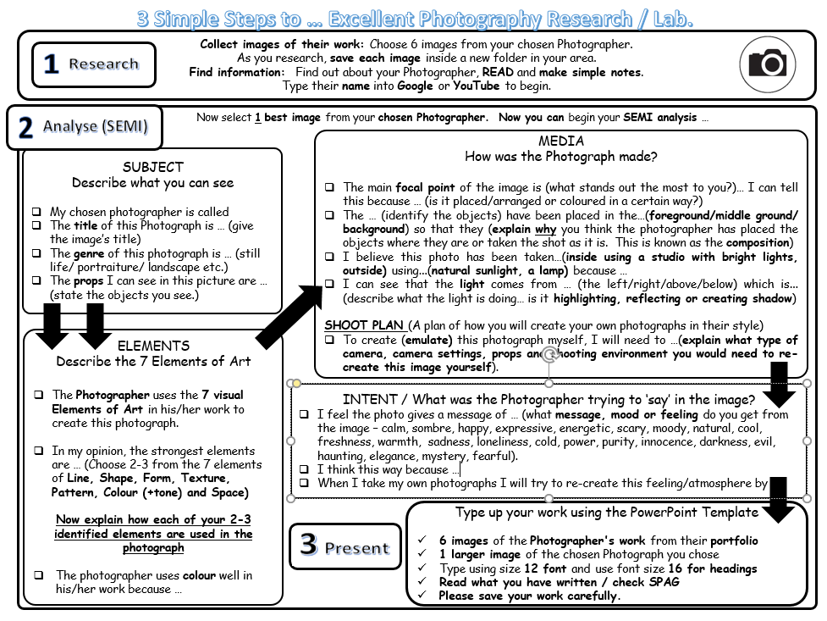
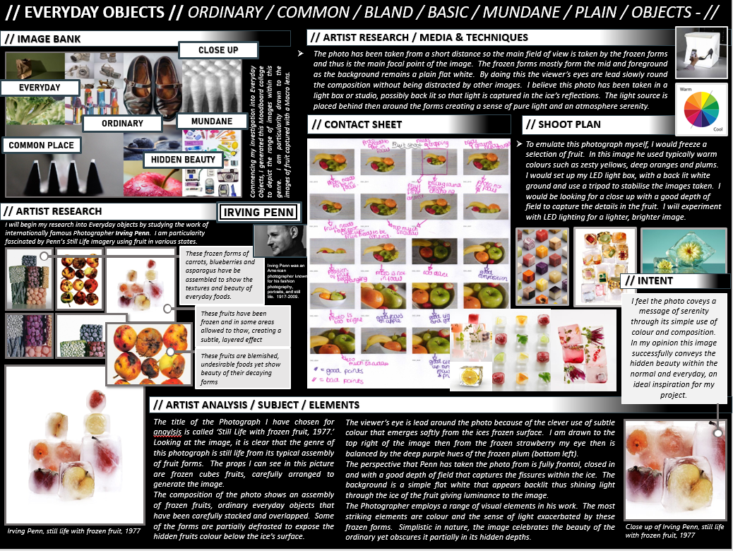
Task 5: Complete SEMI Analysis
Complete the SEMI analysis sentence starters on this one photograph.
We did SEMI analysis in both Year 8 & 9 so you should be used to this☺
EVERYDAY OBJECTS / STILL LIFE
Example
Miss Morris / Head of Art & Design and Photography

Slide 16
SEMI Analysis …
SUBJECT
Describe what you can see
My chosen photographer is called
The title of this Photograph is … (give the image’s title)
The genre of this photograph is … (still life/ portraiture/ landscape etc.)
The props I can see in this picture are … (state the objects you see.)
EVERYDAY OBJECTS / STILL LIFE
ELEMENTS
Describe the 7 Elements of Art
The Photographer uses the 7 visual Elements of Art in his/her work to create this photograph.
In my opinion, the strongest elements are … (Choose 2-3 from the 7 elements of Line, Shape, Form, Texture, Pattern, Colour (+tone) and Space)
Now explain how each of your 2-3 identified elements are used in the photograph
The photographer uses colour well in his/her work because …
MEDIA
How was the Photograph made?
The main focal point of the image is (what stands out the most to you?)… I can tell this because … (is it placed/arranged or coloured in a certain way?)
The … (identify the objects) have been placed in the…(foreground/middle ground/ background) so that they (explain why you think the photographer has placed the objects where they are or taken the shot as it is. This is known as the composition)
I believe this photo has been taken…(inside using a studio with bright lights, outside) using...(natural sunlight, a lamp) because …
I can see that the light comes from … (the left/right/above/below) which is... (describe what the light is doing… is it highlighting, reflecting or creating shadow)
SHOOT PLAN (A plan of how you will create your own photographs in their style)
To create (emulate) this photograph myself, I will need to …(explain what type of camera, camera settings, props and shooting environment you would need to re-create this image yourself).
INTENT / What was the Photographer trying to ‘say’ in the image?
I feel the photo gives a message of … (what message, mood or feeling do you get from the image – calm, sombre, happy, expressive, energetic, scary, moody, natural, cool, freshness, warmth, sadness, loneliness, cold, power, purity, innocence, darkness, evil, haunting, elegance, mystery, fearful).
I think this way because …
When I take my own photographs I will try to re-create this feeling/atmosphere by …

Slide 17
3 Simple Steps to … Excellent Photography Research / Lab.
Collect images of their work: Choose 6 images from your chosen Photographer.
As you research, save each image inside a new folder in your area.
Find information: Find out about your Photographer, READ and make simple notes.
Type their name into Google or YouTube to begin.
1
Research
Now select 1 best image from your chosen Photographer. Now you can begin your SEMI analysis …
MEDIA
How was the Photograph made?
The main focal point of the image is (what stands out the most to you?)… I can tell this because … (is it placed/arranged or coloured in a certain way?)
The … (identify the objects) have been placed in the…(foreground/middle ground/ background) so that they (explain why you think the photographer has placed the objects where they are or taken the shot as it is. This is known as the composition)
I believe this photo has been taken…(inside using a studio with bright lights, outside) using...(natural sunlight, a lamp) because …
I can see that the light comes from … (the left/right/above/below) which is... (describe what the light is doing… is it highlighting, reflecting or creating shadow)
SHOOT PLAN (A plan of how you will create your own photographs in their style)
To create (emulate) this photograph myself, I will need to …(explain what type of camera, camera settings, props and shooting environment you would need to re-create this image yourself).
SUBJECT
Describe what you can see
My chosen photographer is called
The title of this Photograph is … (give the image’s title)
The genre of this photograph is … (still life/ portraiture/ landscape etc.)
The props I can see in this picture are … (state the objects you see.)
ELEMENTS
Describe the 7 Elements of Art
The Photographer uses the 7 visual Elements of Art in his/her work to create this photograph.
In my opinion, the strongest elements are … (Choose 2-3 from the 7 elements of Line, Shape, Form, Texture, Pattern, Colour (+tone) and Space)
Now explain how each of your 2-3 identified elements are used in the photograph
The photographer uses colour well in his/her work because …
INTENT / What was the Photographer trying to ‘say’ in the image?
I feel the photo gives a message of … (what message, mood or feeling do you get from the image – calm, sombre, happy, expressive, energetic, scary, moody, natural, cool, freshness, warmth, sadness, loneliness, cold, power, purity, innocence, darkness, evil, haunting, elegance, mystery, fearful).
I think this way because …
When I take my own photographs I will try to re-create this feeling/atmosphere by …
Type up your work using the PowerPoint Template
6 images of the Photographer's work from their portfolio
1 larger image of the chosen Photograph you chose
Type using size 12 font and use font size 16 for headings
Read what you have written / check SPAG
Please save your work carefully.
Miss Morris / Head of Art & Design and Photography

Slide 18
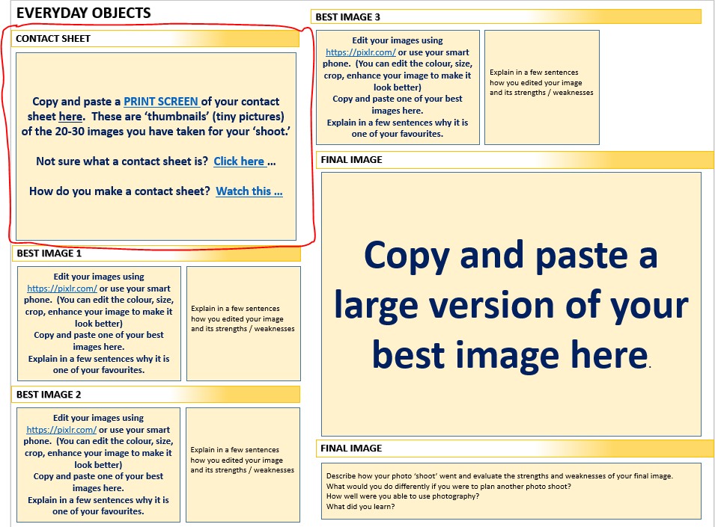
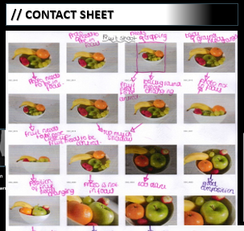
Task 6: Create a Contact Sheet
Copy and paste a PRINT SCREEN of your contact sheet here. These are ‘thumbnails’ (tiny pictures) of the 20-30 images you have taken for your ‘shoot.’
Not sure what a contact sheet is? Click here …
How do you make a contact sheet? Watch this …
EVERYDAY OBJECTS / STILL LIFE
Example
Miss Morris / Head of Art & Design and Photography

Slide 19
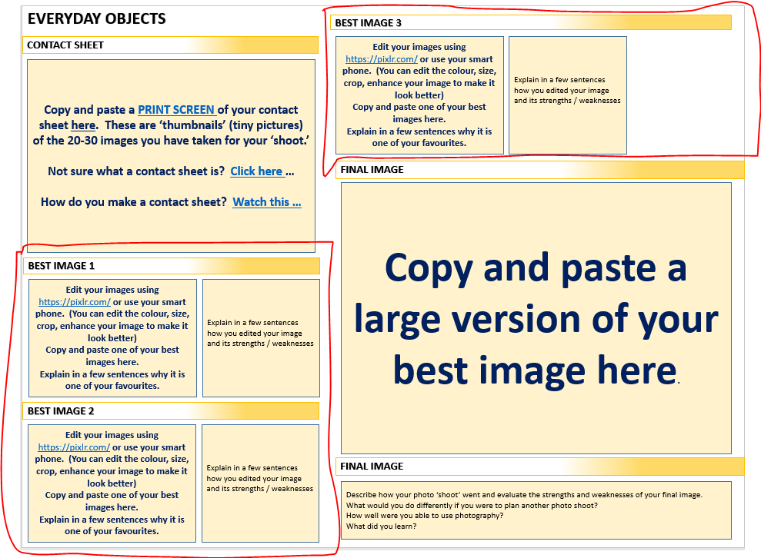
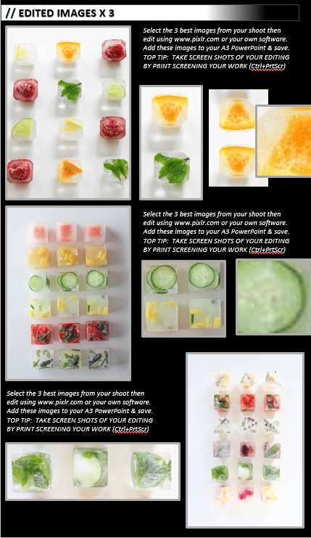
Task 7: Select and EDIT best images
Edit your images using https://pixlr.com/ or use your smart phone. (You can edit the colour, size, crop, enhance your image to make it look better)
Copy and paste one of your best images here.
Explain in a few sentences why it is one of your favourites.
EVERYDAY OBJECTS / STILL LIFE
Example
Miss Morris / Head of Art & Design and Photography

Slide 20
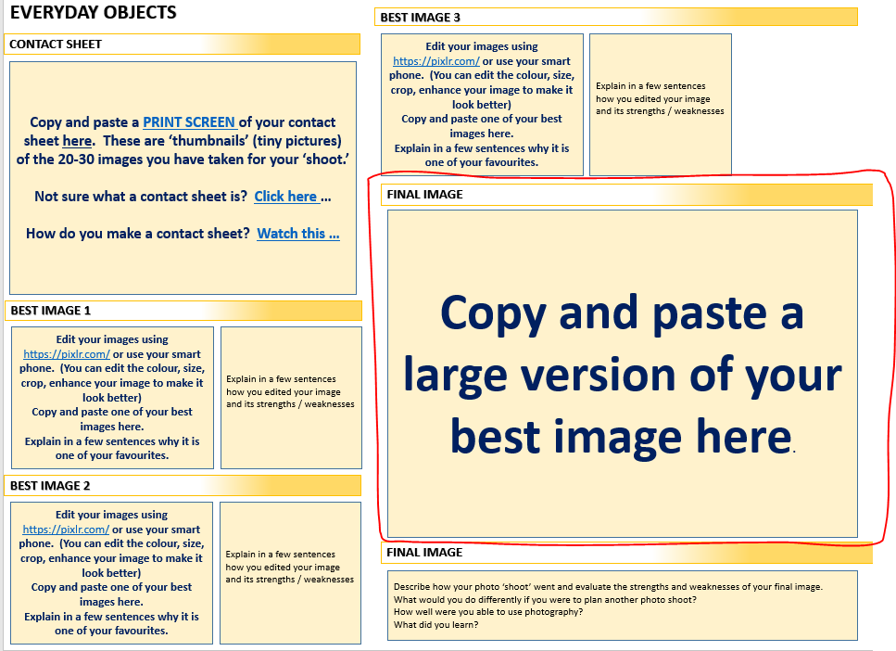
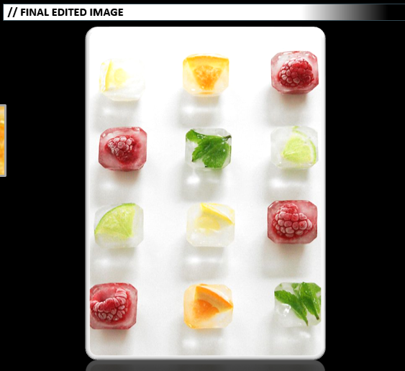
Task 8: Select Final Image
Copy and paste a large version of your best image
EVERYDAY OBJECTS / STILL LIFE
Example
Miss Morris / Head of Art & Design and Photography

Slide 21
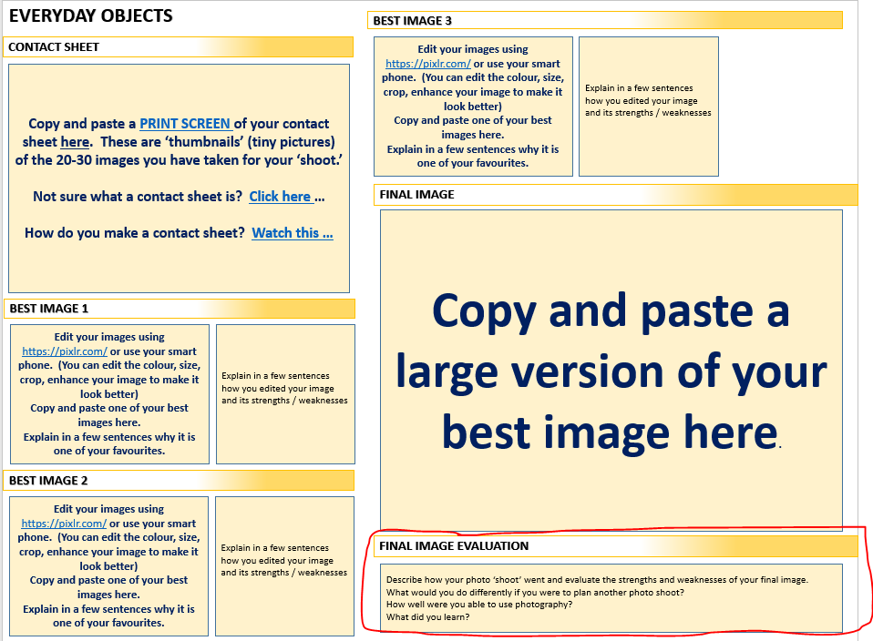
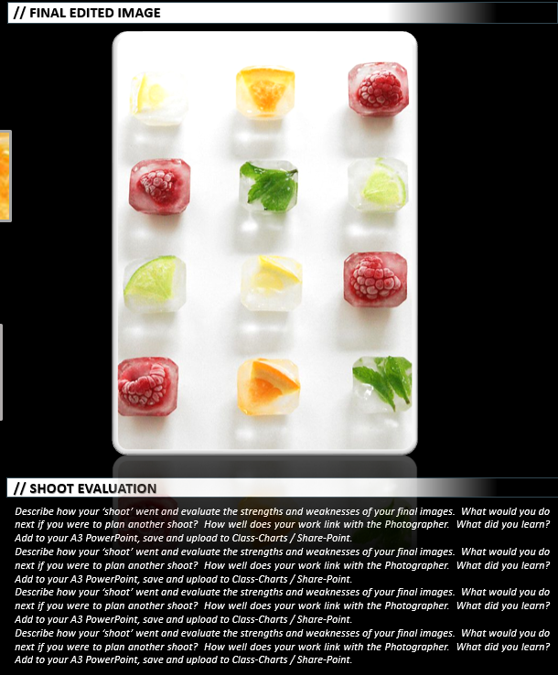
Task 9: Evaluation
Describe how your photo ‘shoot’ went and evaluate the strengths and weaknesses of your final image.
What would you do differently if you were to plan another photo shoot?
How well were you able to use photography?
What did you learn?
EVERYDAY OBJECTS / STILL LIFE
Example
Miss Morris / Head of Art & Design and Photography

Slide 22
EVERYDAY OBJECTS
IMAGES FROM THE INTERNET
SEMI ANALYSIS (Done in year 8 & 9)
YOUR FAVORITE IRVING PENN IMAGE
Copy and paste 6 x images here from the internet based on Everyday Object Photography
SUBJECT
Copy and paste your favourite Irving Penn Still Life image here.
This should be one you would like to copy the style of (emulate)
My chosen photographer is called…
The title of this Photograph is … (give the image’s title)
The genre of this photograph is … (still life/ portraiture/ landscape etc.)
The props I can see in this picture are … (state the objects you see.)
ELEMENTS
The Photographer uses the 7 visual Elements of Art in his/her work to create this photograph.
In my opinion the strongest elements are … (Choose 2-3 from the 7 elements of Line, Shape, Form, Texture, Pattern, Colour (+tone) and Space)
Now explain how each of your 2-3 identified elements are used in the photograph
The photographer uses colour well in his/her work because …
WHAT IS STILL LIFE PHOTOGRAPHY?
IN YOUR OWN WORDS, using size 12 font, type here to explain what still life photography is.
MEDIA
The main focal point of the image is (what stands out the most to you?)… I can tell this because …
The … (identify the objects) have been placed in the…(foreground/middle ground/ background) so that they (explain why you think the photographer has placed the objects where they are or taken the shot as it is. This is known as the composition)
I believe this photo has been taken…(inside using a studio with bright lights, outside) using...(natural sunlight, a lamp) because …
I can see that the light comes from … (the left/right/above/below) which is... (describe what the light is doing… is it highlighting, reflecting or creating shadow)
SHOOT PLAN (A plan of how you will create your own photographs in their style)
To create (emulate) this photograph myself, I will need to …(explain what type of camera, camera settings, props and shooting environment you would need to re-create this image yourself).
IMAGES OF IRVING PENN’S PHOTOGRAPHY
Copy and paste 6 x STILL LIFE images here from the internet based on Irving Penn
SHOOT PLAN
INTENT
I feel the photo gives a message of … (what message, mood or feeling do you get from the image – calm, sombre, happy, expressive, energetic, scary, moody, natural, cool, freshness, warmth, sadness, loneliness, cold, power, purity, innocence, darkness, evil, haunting, elegance, mystery, fearful).
I think this way because …
When I create my own photographs I will try to re-create this feeling/atmosphere by …
Miss Morris / Head of Art & Design and Photography

Slide 23
EVERYDAY OBJECTS
BEST IMAGE 3
CONTACT SHEET
Edit your images using https://pixlr.com/ or use your smart phone. (You can edit the colour, size, crop, enhance your image to make it look better)
Copy and paste one of your best images here.
Explain in a few sentences why it is one of your favourites.
Explain in a few sentences how you edited your image and its strengths / weaknesses
Copy and paste a PRINT SCREEN of your contact sheet here. These are ‘thumbnails’ (tiny pictures) of the 20-30 images you have taken for your ‘shoot.’
Not sure what a contact sheet is? Click here …
How do you make a contact sheet? Watch this …
FINAL IMAGE
Copy and paste a large version of your best image here.
BEST IMAGE 1
Edit your images using https://pixlr.com/ or use your smart phone. (You can edit the colour, size, crop, enhance your image to make it look better)
Copy and paste one of your best images here.
Explain in a few sentences why it is one of your favourites.
Explain in a few sentences how you edited your image and its strengths / weaknesses
BEST IMAGE 2
Edit your images using https://pixlr.com/ or use your smart phone. (You can edit the colour, size, crop, enhance your image to make it look better)
Copy and paste one of your best images here.
Explain in a few sentences why it is one of your favourites.
Explain in a few sentences how you edited your image and its strengths / weaknesses
FINAL IMAGE EVALUATION
Describe how your photo ‘shoot’ went and evaluate the strengths and weaknesses of your final image.
What would you do differently if you were to plan another photo shoot?
How well were you able to use photography?
What did you learn?
Miss Morris / Head of Art & Design and Photography

