Slide 1
GCSE Photography HOME LEARNING
SUMMER PREPARATION
BOOKLET 2020
GCSE PHOTOGRAPHY / SUMMER PREPARATION
Miss Morris / Head of Art & Design and Photography

Slide 2
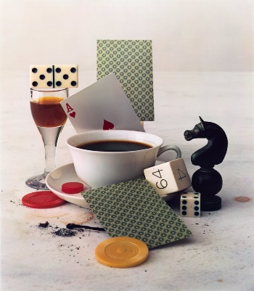
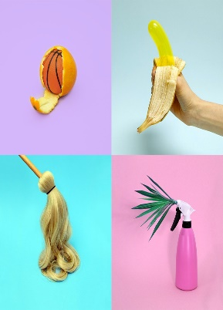
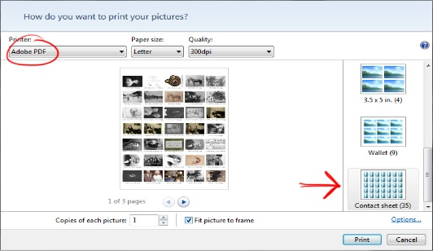
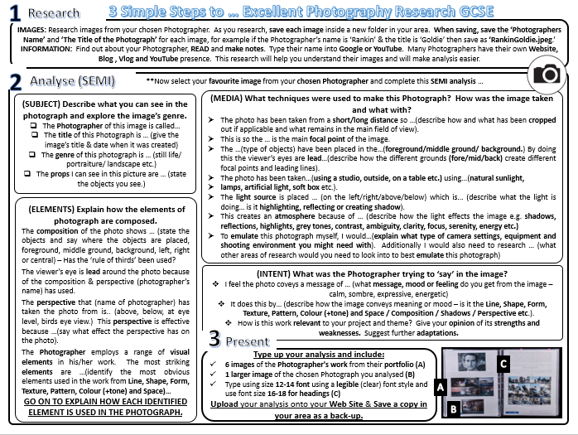
GCSE Photography HOME LEARNING
Task 2: ARTIST RESEARCH
Enter Text here …
Write your ‘Shoot Plan’ that explains how you will set up your photography shoot in the style of your chosen Photographer. Consider what props, lighting, location, backgrounds, compositional elements and viewpoints you might use. Type up your ‘Shoot Plan’ on your A3 PowerPoint & save.
Take your shoot of at least 20 photographs. Download these onto your computer and print screen (Ctrl+PrtScr) them onto your A3 PowerPoint slide & save.
Select the 3 best images from your shoot then edit using www.pixlr.com or your own software. Add these images to your A3 PowerPoint & save.
TOP TIP: TAKE SCREEN SHOTS OF YOUR EDITING BY PRINT SCREENING YOUR WORK (Ctrl+PrtScr)
Describe how your ‘shoot’ went and evaluate the strengths and weaknesses of your final images. What would you do next if you were to plan another shoot? How well does your work link with the Photographer. What did you learn? Add to your A3 PowerPoint, save and upload to Class-Charts / Share-Point.
Task 3: PLAN
Everyday Objects are popular subject genre in Still Life Photography. Getting in close on an ordinary subject is a good way to look, and think, about it a bit differently.
Irving Penn, After-
dinner games, 1947
Research the Still Life work of either Irving Penn , Vanessa McKeown or Jim Golden.
Choose 6 of your favourite images of your chosen Photographer's work and collage them together using www.photocollage.com/. Add to your A3 PowerPoint sheet & save.
Next, choose one image from your photographer, something that you might be able to re-create at home, and analyse using the SEMI analysis worksheet. (You may remember using SEMI in KS3 Art). Add this research to your A3 PowerPoint sheet & save.
To prepare yourselves for the start of your Photography GCSE we would like you to complete the following three tasks over June, July and in your Summer Holidays.
You have chosen Photography and we hope that you will be as passionate about the subject as we are. This means that we expect you to show dedication by completing the following tasks to the best of your ability and then submit them on Class-Charts ready for your first lesson in September.
Each project should take A MINIMUM OF FOUR HOURS OF YOUR TIME. Please email me if you have problems to g.morris@penworthamgirls.lancs.sch.uk.
When PRESENTING your work, you need to set up a PowerPoint slide to A3 size. You must not hand write – all annotation is to be typed up using size 12 font only. Headings can be in size 16 font. Please choose a professional typeface (or font) that is legible (readable).
EVERYDAY OBJECTS / STILL LIFE
Task 4: CREATE
Jim Golden, Camera
Collection (caption), 2013
Vanessa McKeown
Task 1: CREATE 1st A3 SHEET
Task 5: EVALUATE
Watch the video on YouTube and set up your PowerPoint to A3 & Landscape.
https://www.youtube.com/watch?v=08NdIsOiKzA
Save your new PowerPoint as SummerProjectYourName. Using a computer is a major part of GCSE Photography so it is important to get used to using one regularly.
Miss Morris / Head of Art & Design and Photography

Slide 3
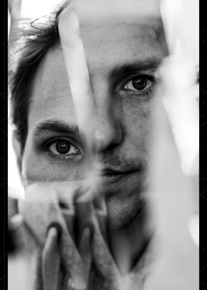
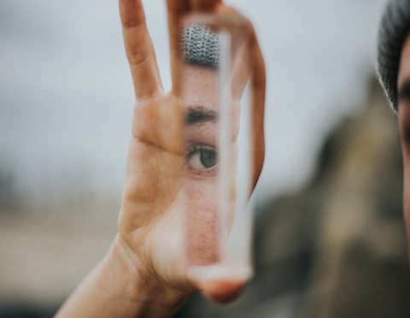
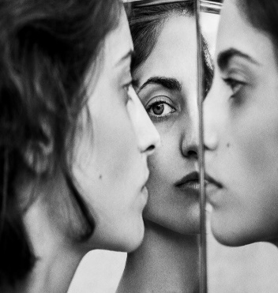
GCSE Photography HOME LEARNING
Task 2: TECHNIQUE RESEARCH
Enter Text here …
Write your ‘Shoot Plan’ that explains how you will set up your photography mirror shoot. Consider what props, lighting, location, backgrounds, compositional elements and viewpoints you might use. Type up your ‘Shoot Plan’ on your A3 PowerPoint & save.
Take your shoot of at least 20 photographs. Download these onto your computer and print screen (Ctrl+PrtScr) them onto your A3 PowerPoint slide & save.
Select the 3 best images from your shoot then edit using www.pixlr.com or your own software. Add these images to your A3 PowerPoint & save.
TOP TIP: TAKE SCREEN SHOTS OF YOUR EDITING BY PRINT SCREENING YOUR WORK (Ctrl+PrtScr)
Describe how your ‘shoot’ went and evaluate the strengths and weaknesses of your final images. What would you do next if you were to plan another shoot? How well were you able to use mirror photography? What did you learn? Add to your A3 PowerPoint, save and upload to Class-Charts.
Task 3: PLAN
Reflection photography, also referred to as mirror photography, is when you use reflective surfaces, such as a mirror or water to create an artistic echo of a scene. This type of photography can add an interesting effects to your portraiture shoots.
Reflections in surfaces such as water, mirror glass, windows and metallic objects are sometimes recorded by photographers and filmmakers to create distorted images or to frame a view.
Research examples of ‘Mirror Photography’ or ‘Reflection Photography’ using Pinterest & Google. Choose 12 of your favourite inspirational images to create an IMAGE BANK then collage them together using www.photocollage.com/. Add to your A3 PowerPoint sheet & save.
Research techniques on how to create ‘Mirror Photography’ on YouTube. Choose your favourite technique, type it up on your A3 PowerPoint and include images on how to create this technique. Save your work.
Here are some examples https://www.youtube.com/watch?v=fvcUGlwonww
To prepare yourselves for the start of your Photography GCSE we would like you to complete the following three tasks over June, July and in your Summer Holidays.
You have chosen Photography and we hope that you will be as passionate about the subject as we are. This means that we expect you to show dedication by completing the following tasks to the best of your ability and then submit them on Class-Charts ready for your first lesson in September.
Each project should take A MINIMUM OF FOUR HOURS OF YOUR TIME. Please email me if you have problems to g.morris@penworthamgirls.lancs.sch.uk.
When PRESENTING your work, you need to set up a PowerPoint slide to A3 size. You must not hand write – all annotation is to be typed up using size 12 font only. Headings can be in size 16 font. Please choose a professional typeface (or font) that is legible (readable).
Task 4: CREATE
MIRROR PHOTOGRAPHY / PORTRAITURE
Task 1: CREATE 2nd A3 SHEET
Task 5: EVALUATE
Create a 2nd sheet on your PowerPoint. Save your PowerPoint as SummerProjectYourName.
Using a computer is a major part of GCSE Photography so it is important to get used to using one regularly.
Miss Morris / Head of Art & Design and Photography

Slide 4
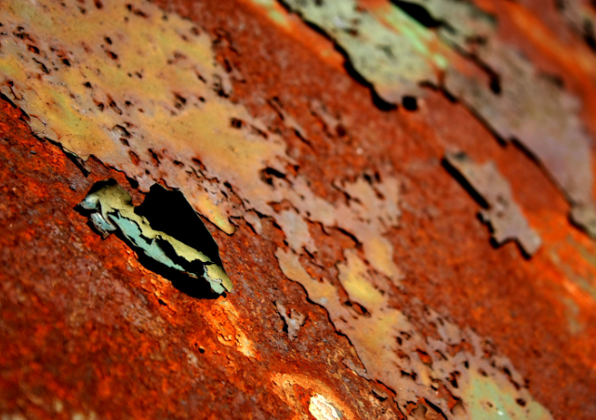
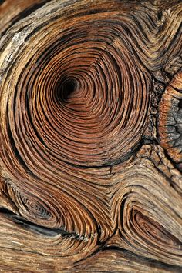
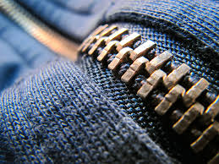
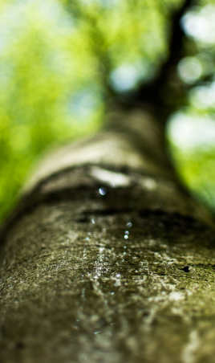
GCSE Photography HOME LEARNING
Task 2: ARTIST RESEARCH
Task 3: PLAN
Enter Text here …
Write your ‘Shoot Plan’ that explains how you will set up your texture walk (indoors or outdoors). Bring a tripod or make a DIY tripod to stabilise your images. Type up your ‘Shoot Plan’ on your A3 PowerPoint & save.
Take your shoot of at least 20 photographs. Download these onto your computer and print screen (Ctrl+PrtScr) them onto your A3 PowerPoint slide & save.
Select the 3 best images from your shoot then edit using www.pixlr.com or your own software. Add these images to your A3 PowerPoint & save.
TOP TIP: TAKE SCREEN SHOTS OF YOUR EDITING BY PRINT SCREENING YOUR WORK (Ctrl+PrtScr)
Describe how your ‘shoot’ went and evaluate the strengths and weaknesses of your final images. What would you do next if you were to plan another shoot? How well were you able to capture textures around you? What did you learn? Add to your A3 PowerPoint, save and upload to Class-Charts.
Macro Photography enables us capture amazing details from the textures all around us. Some cameras have a macro setting that allows you to get close, other DSLR cameras have Macro Lens attachments. You can even get pretty close with your own camera phone but in all cases you must hold VERY still or use a tripod.
Get close and look for textures and patterns in surfaces such as wood, fabrics, zips, rusty objects, flooring, inside washing machines, nature, bricks and stones etc. Macro or Close up Photography will create some wonderfully abstract images.
Research examples of ‘Texture Photography.’ Choose 12 of your favourite inspirational images to create an IMAGE BANK and collage them together using https://www.photocollage.com/. Add to your A3 PowerPoint sheet & save.
Research the work of Lucy Shires. Choose 6 of your favourite images of your chosen Photographer's work and collage them together using www.photocollage.com/. Add to your A3 PowerPoint sheet & save.
Next, choose one image from Lucy Shire’s Texture work, and analyse using the SEMI analysis worksheet.
To prepare yourselves for the start of your Photography GCSE we would like you to complete the following three tasks over June, July and in your Summer Holidays.
You have chosen Photography and we hope that you will be as passionate about the subject as we are. This means that we expect you to show dedication by completing the following tasks to the best of your ability and then submit them on Class-Charts ready for your first lesson in September.
Each project should take A MINIMUM OF FOUR HOURS OF YOUR TIME. Please email me if you have problems to g.morris@penworthamgirls.lancs.sch.uk.
When PRESENTING your work, you need to set up a PowerPoint slide to A3 size. You must not hand write – all annotation is to be typed up using size 12 font only. Headings can be in size 16 font. Please choose a professional typeface (or font) that is legible (readable).
MACRO PHOTOGRAPHY / TEXTURE
Task 4: CREATE
Task 1: CREATE 3rd A3 SHEET
Task 5: EVALUATE
Create a 3rd sheet on your PowerPoint. Save your PowerPoint as SummerProjectYourName.
Using a computer is a major part of GCSE Photography so it is important to get used to using one regularly.
Miss Morris / Head of Art & Design and Photography

Slide 5
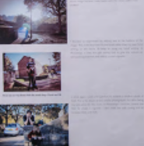
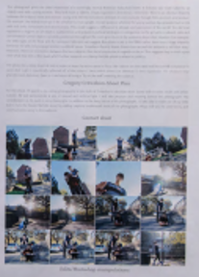
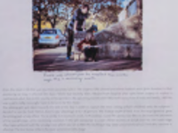
GCSE Photography HOME LEARNING
IMAGE BANK X 12 / ARTIST IMAGES X 6
EXAMPLE LAYOUT / PRESENTATION
EDITED IMAGES / SCREEN SHOTS
CHOSEN IMAGE FROM ARTIST / IMAGE BANK
SEMI ANALYSIS / TECHNIQUES
SHOOT PLAN
FINAL IMAGE
CONTACT SHEET X 20 IMAGES
EVALUATION
Miss Morris / Head of Art & Design and Photography

