Slide 1
GCSE Photography HOME LEARNING
Lab.
SUMMER PREPARATION
BOOKLET 2020
GCSE PHOTOGRAPHY / SUMMER PREPARATION
Miss Morris / Head of Art & Design and Photography

Slide 2
Over the Summer holidays we would like you to complete the following tasks. You can use this PowerPoint as a Template for your work.
You have chosen to do Photography so that means your enjoy taking pictures and using a computer.
Please email me if you have problems to g.morris@penworthamgirls.lancs.sch.uk
Please start typing into this PowerPoint at it has already been set up to A3 size for you. Click here to start editing it.
Only use size 12 font when typing.
INTRODUCTION

Slide 3
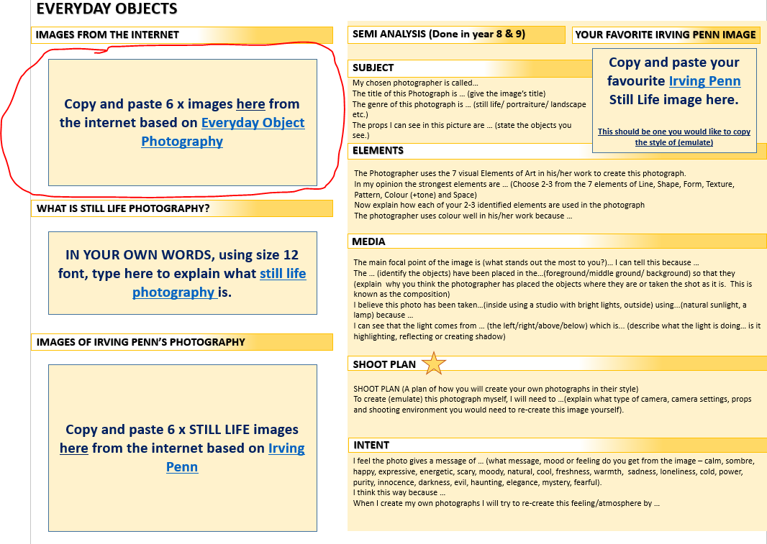
Task 1: IMAGES FROM THE INTERNET
Copy and paste 6 x images from the internet based on Everyday Object Photography
EVERYDAY OBJECTS / STILL LIFE
Example

Slide 4
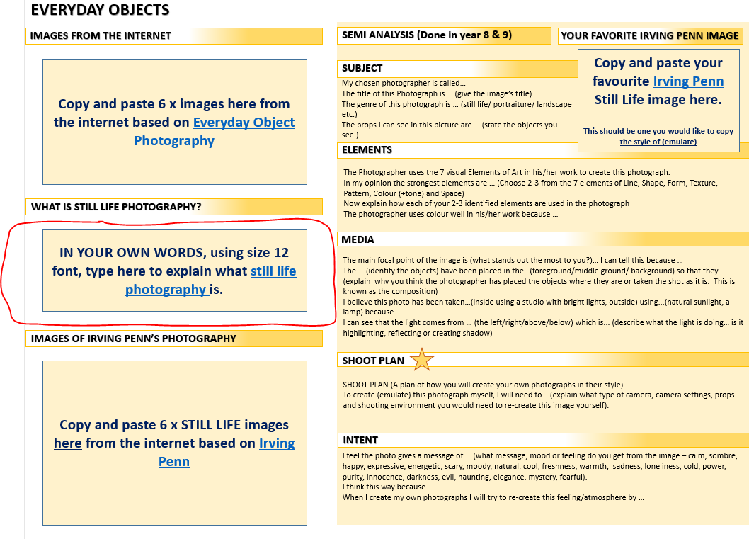
Task 2: Find out what Still Life Means
IN YOUR OWN WORDS, using size 12 font, type to explain what still life photography is.
EVERYDAY OBJECTS / STILL LIFE
Example
Still life photography is …

Slide 5
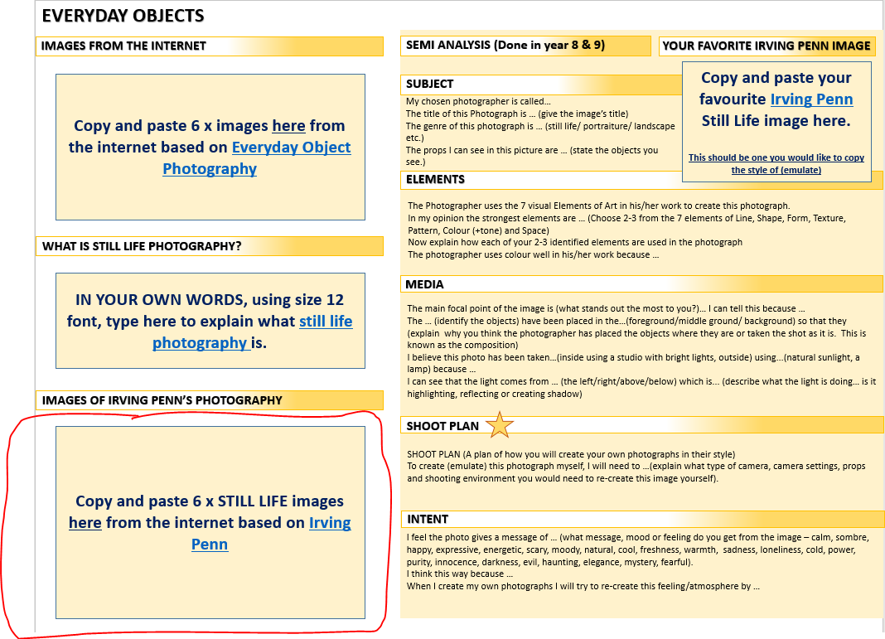
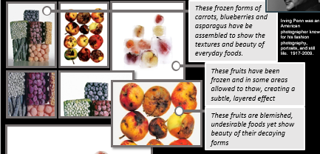
Task 3: Collect images
Copy and paste 6 x STILL LIFE images from the internet based on Irving Penn
EVERYDAY OBJECTS / STILL LIFE
Example

Slide 6
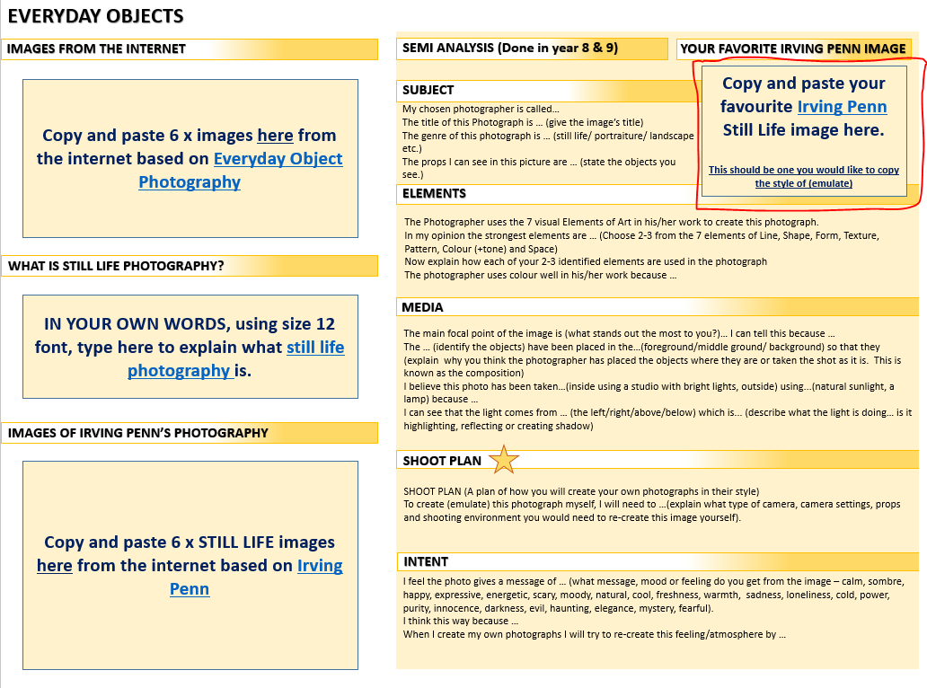
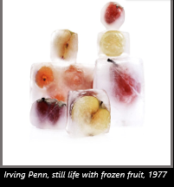
Task 4: Choose 1 best image
Copy and paste your favourite Irving Penn Still Life image here.
This should be one you would like to copy the style of (emulate)
EVERYDAY OBJECTS / STILL LIFE
Example

Slide 7
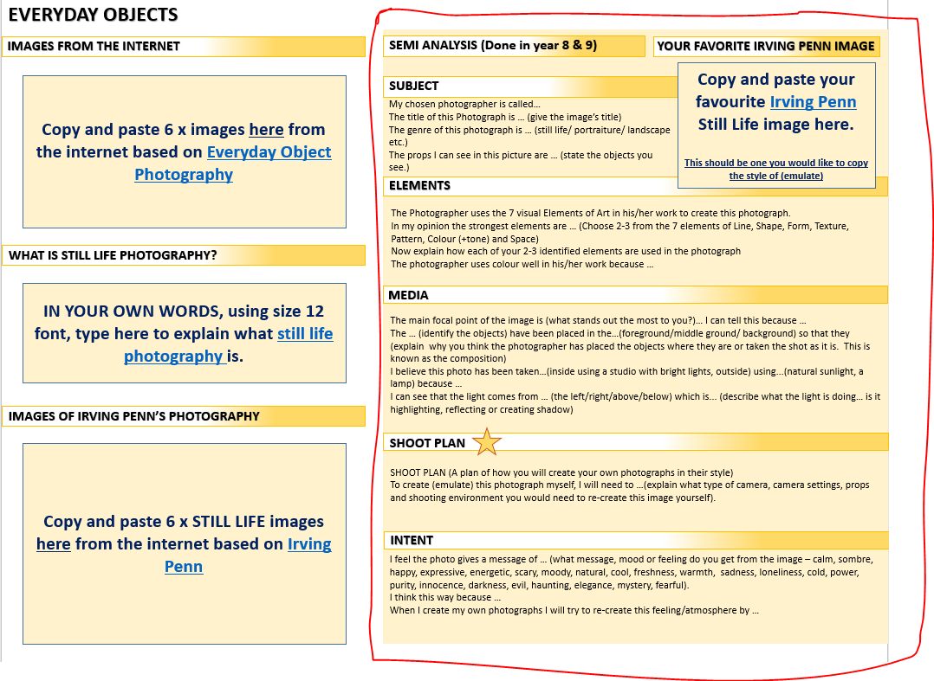
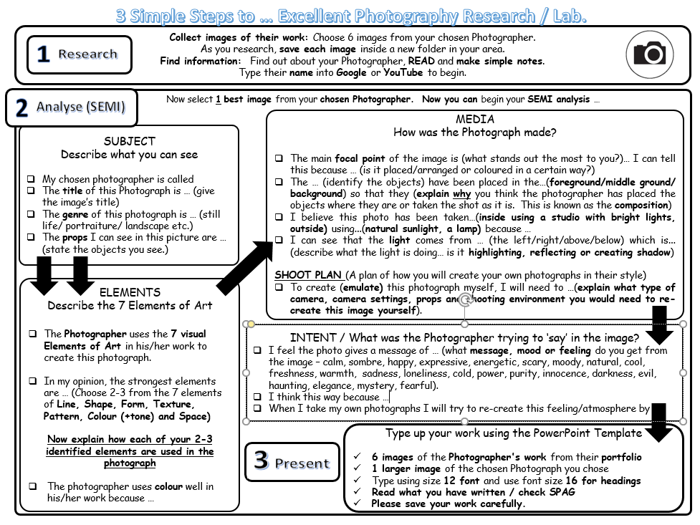
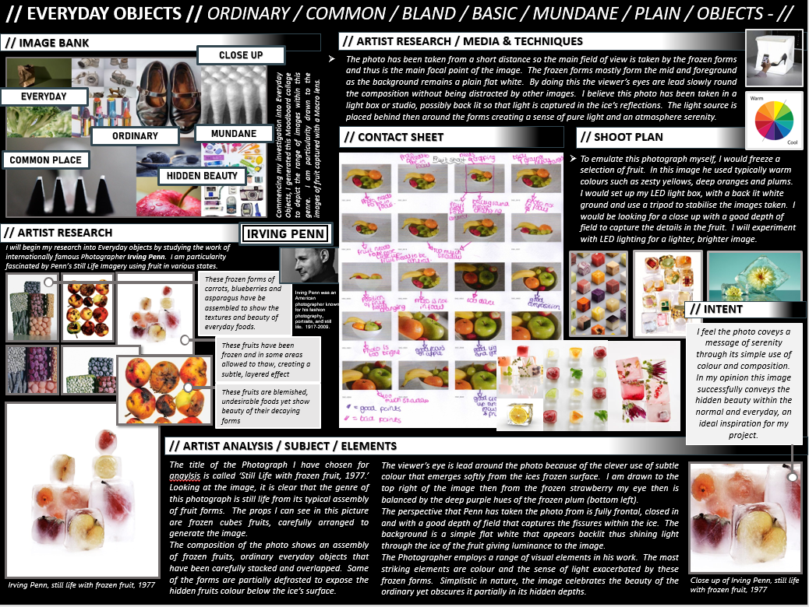
Task 5: Complete SEMI Analysis
Complete the SEMI analysis sentence starters on this one photograph.
We did SEMI analysis in both Year 8 & 9 so you should be used to this☺
EVERYDAY OBJECTS / STILL LIFE
Example

Slide 8
SEMI Analysis …
SUBJECT
Describe what you can see
My chosen photographer is called
The title of this Photograph is … (give the image’s title)
The genre of this photograph is … (still life/ portraiture/ landscape etc.)
The props I can see in this picture are … (state the objects you see.)
EVERYDAY OBJECTS / STILL LIFE
ELEMENTS
Describe the 7 Elements of Art
The Photographer uses the 7 visual Elements of Art in his/her work to create this photograph.
In my opinion, the strongest elements are … (Choose 2-3 from the 7 elements of Line, Shape, Form, Texture, Pattern, Colour (+tone) and Space)
Now explain how each of your 2-3 identified elements are used in the photograph
The photographer uses colour well in his/her work because …
MEDIA
How was the Photograph made?
The main focal point of the image is (what stands out the most to you?)… I can tell this because … (is it placed/arranged or coloured in a certain way?)
The … (identify the objects) have been placed in the…(foreground/middle ground/ background) so that they (explain why you think the photographer has placed the objects where they are or taken the shot as it is. This is known as the composition)
I believe this photo has been taken…(inside using a studio with bright lights, outside) using...(natural sunlight, a lamp) because …
I can see that the light comes from … (the left/right/above/below) which is... (describe what the light is doing… is it highlighting, reflecting or creating shadow)
SHOOT PLAN (A plan of how you will create your own photographs in their style)
To create (emulate) this photograph myself, I will need to …(explain what type of camera, camera settings, props and shooting environment you would need to re-create this image yourself).
INTENT / What was the Photographer trying to ‘say’ in the image?
I feel the photo gives a message of … (what message, mood or feeling do you get from the image – calm, sombre, happy, expressive, energetic, scary, moody, natural, cool, freshness, warmth, sadness, loneliness, cold, power, purity, innocence, darkness, evil, haunting, elegance, mystery, fearful).
I think this way because …
When I take my own photographs I will try to re-create this feeling/atmosphere by …

Slide 9
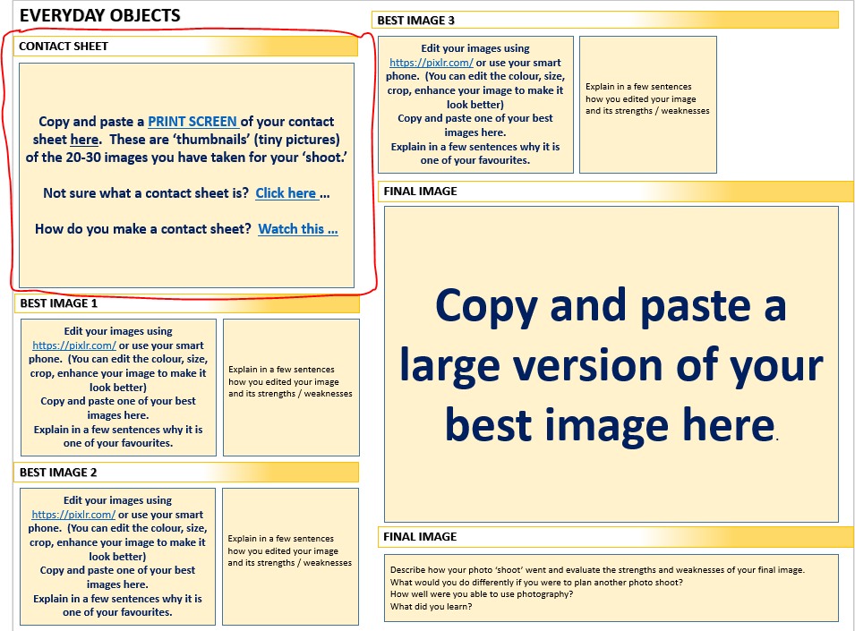
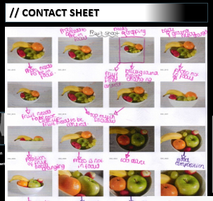
Task 6: Create a Contact Sheet
Copy and paste a PRINT SCREEN of your contact sheet here. These are ‘thumbnails’ (tiny pictures) of the 20-30 images you have taken for your ‘shoot.’
Not sure what a contact sheet is? Click here …
How do you make a contact sheet? Watch this …
EVERYDAY OBJECTS / STILL LIFE
Example

Slide 10
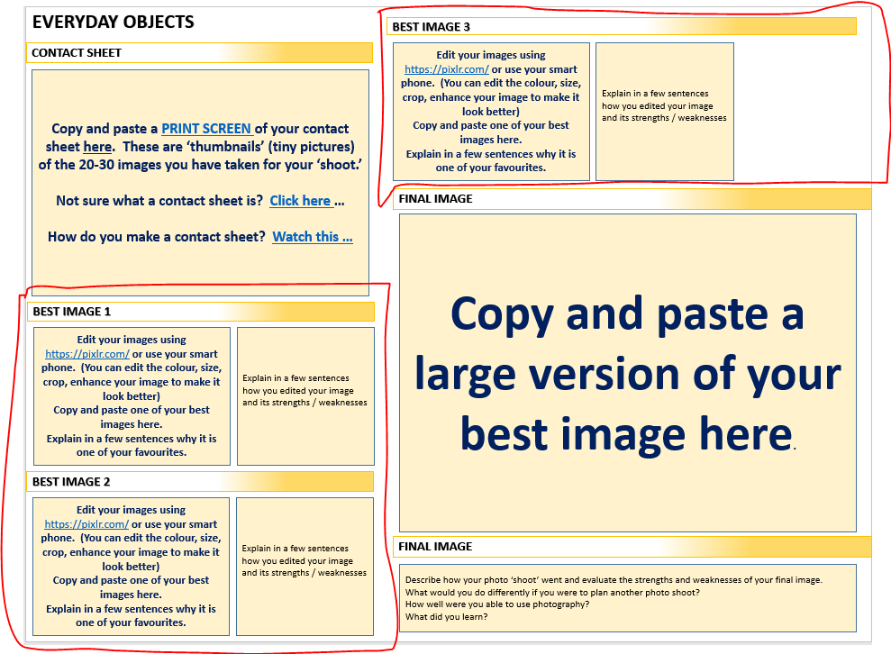
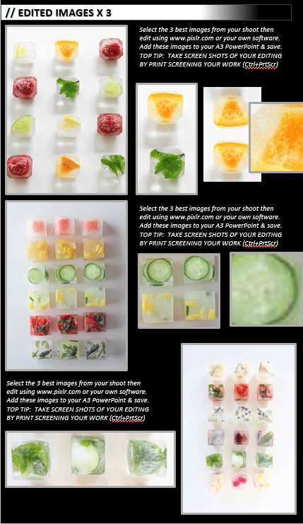
Task 7: Select and EDIT best images
Edit your images using https://pixlr.com/ or use your smart phone. (You can edit the colour, size, crop, enhance your image to make it look better)
Copy and paste one of your best images here.
Explain in a few sentences why it is one of your favourites.
EVERYDAY OBJECTS / STILL LIFE
Example

Slide 11
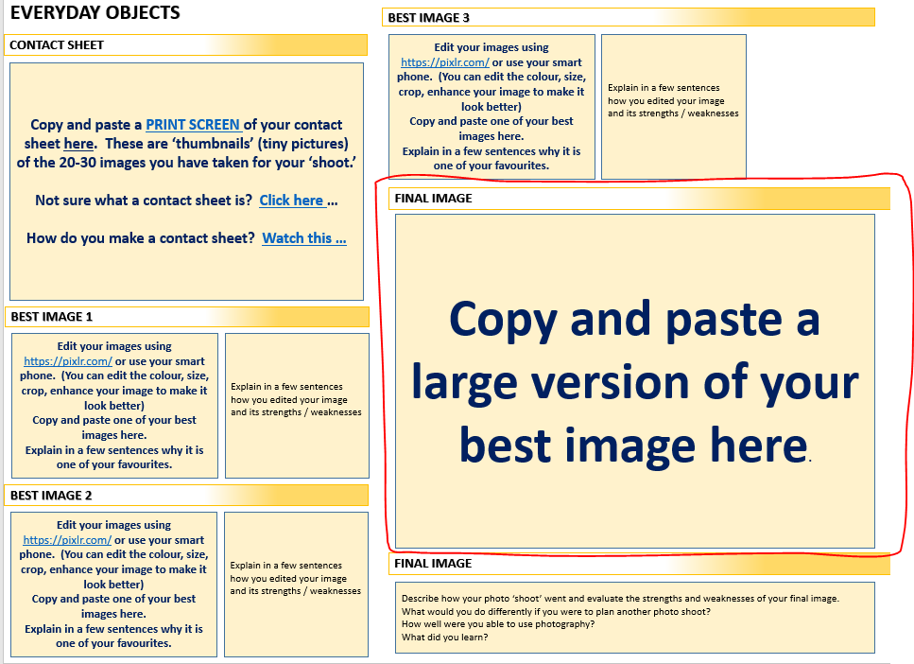
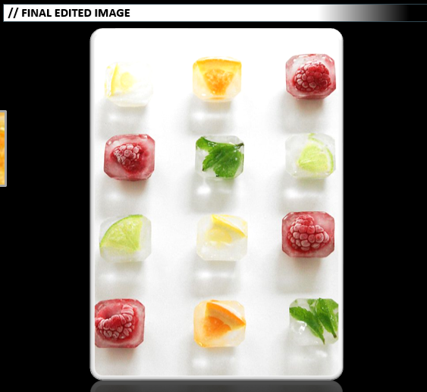
Task 8: Select Final Image
Copy and paste a large version of your best image
EVERYDAY OBJECTS / STILL LIFE
Example

Slide 12
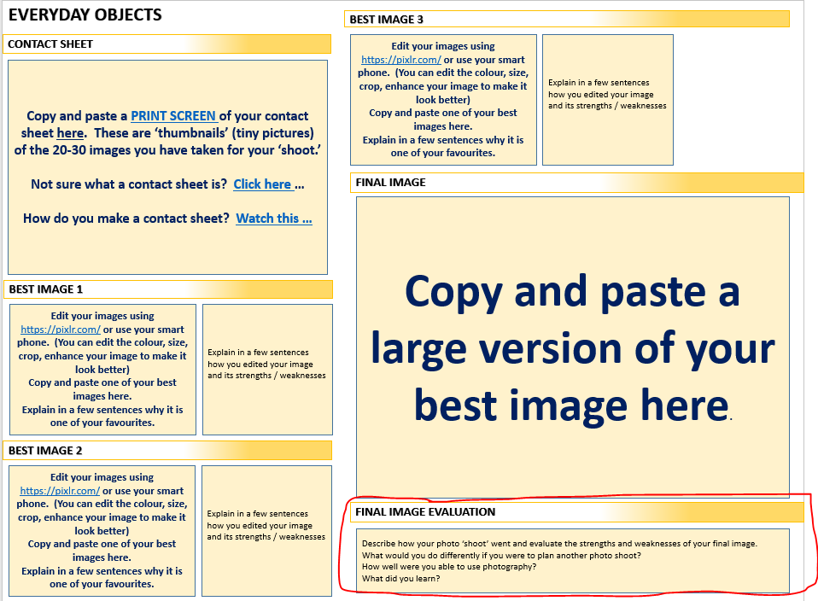
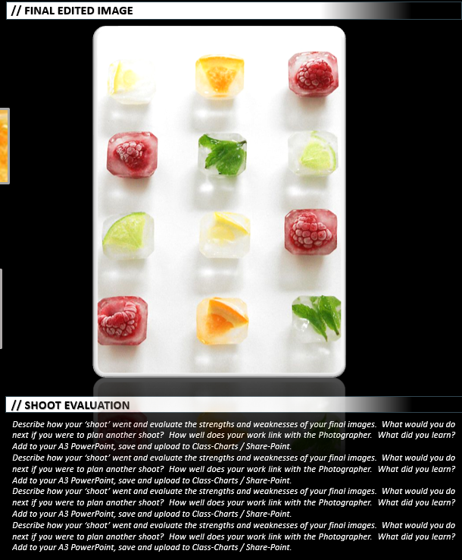
Task 9: Evaluation
Describe how your photo ‘shoot’ went and evaluate the strengths and weaknesses of your final image.
What would you do differently if you were to plan another photo shoot?
How well were you able to use photography?
What did you learn?
EVERYDAY OBJECTS / STILL LIFE
Example

Slide 13
EVERYDAY OBJECTS
IMAGES FROM THE INTERNET
SEMI ANALYSIS (Done in year 8 & 9)
YOUR FAVORITE IRVING PENN IMAGE
Copy and paste 6 x images here from the internet based on Everyday Object Photography
SUBJECT
Copy and paste your favourite Irving Penn Still Life image here.
This should be one you would like to copy the style of (emulate)
My chosen photographer is called…
The title of this Photograph is … (give the image’s title)
The genre of this photograph is … (still life/ portraiture/ landscape etc.)
The props I can see in this picture are … (state the objects you see.)
ELEMENTS
The Photographer uses the 7 visual Elements of Art in his/her work to create this photograph.
In my opinion the strongest elements are … (Choose 2-3 from the 7 elements of Line, Shape, Form, Texture, Pattern, Colour (+tone) and Space)
Now explain how each of your 2-3 identified elements are used in the photograph
The photographer uses colour well in his/her work because …
WHAT IS STILL LIFE PHOTOGRAPHY?
IN YOUR OWN WORDS, using size 12 font, type here to explain what still life photography is.
MEDIA
The main focal point of the image is (what stands out the most to you?)… I can tell this because …
The … (identify the objects) have been placed in the…(foreground/middle ground/ background) so that they (explain why you think the photographer has placed the objects where they are or taken the shot as it is. This is known as the composition)
I believe this photo has been taken…(inside using a studio with bright lights, outside) using...(natural sunlight, a lamp) because …
I can see that the light comes from … (the left/right/above/below) which is... (describe what the light is doing… is it highlighting, reflecting or creating shadow)
SHOOT PLAN (A plan of how you will create your own photographs in their style)
To create (emulate) this photograph myself, I will need to …(explain what type of camera, camera settings, props and shooting environment you would need to re-create this image yourself).
IMAGES OF IRVING PENN’S PHOTOGRAPHY
Copy and paste 6 x STILL LIFE images here from the internet based on Irving Penn
SHOOT PLAN
INTENT
I feel the photo gives a message of … (what message, mood or feeling do you get from the image – calm, sombre, happy, expressive, energetic, scary, moody, natural, cool, freshness, warmth, sadness, loneliness, cold, power, purity, innocence, darkness, evil, haunting, elegance, mystery, fearful).
I think this way because …
When I create my own photographs I will try to re-create this feeling/atmosphere by …

Slide 14
EVERYDAY OBJECTS
BEST IMAGE 3
CONTACT SHEET
Edit your images using https://pixlr.com/ or use your smart phone. (You can edit the colour, size, crop, enhance your image to make it look better)
Copy and paste one of your best images here.
Explain in a few sentences why it is one of your favourites.
Explain in a few sentences how you edited your image and its strengths / weaknesses
Copy and paste a PRINT SCREEN of your contact sheet here. These are ‘thumbnails’ (tiny pictures) of the 20-30 images you have taken for your ‘shoot.’
Not sure what a contact sheet is? Click here …
How do you make a contact sheet? Watch this …
FINAL IMAGE
Copy and paste a large version of your best image here.
BEST IMAGE 1
Edit your images using https://pixlr.com/ or use your smart phone. (You can edit the colour, size, crop, enhance your image to make it look better)
Copy and paste one of your best images here.
Explain in a few sentences why it is one of your favourites.
Explain in a few sentences how you edited your image and its strengths / weaknesses
BEST IMAGE 2
Edit your images using https://pixlr.com/ or use your smart phone. (You can edit the colour, size, crop, enhance your image to make it look better)
Copy and paste one of your best images here.
Explain in a few sentences why it is one of your favourites.
Explain in a few sentences how you edited your image and its strengths / weaknesses
FINAL IMAGE EVALUATION
Describe how your photo ‘shoot’ went and evaluate the strengths and weaknesses of your final image.
What would you do differently if you were to plan another photo shoot?
How well were you able to use photography?
What did you learn?

